Slide 1

Soft Tissue Sarcoma Clinical Analytics Dashboard
A Power BI Dashboard for Clinical Decision Support
Presented By Mfoniso Isaac Udo Presented by Certified Oncology Nurse | Data Analyst
Tools Used
Microsoft Power BI | Power Query DAX | Excel

Slide 2

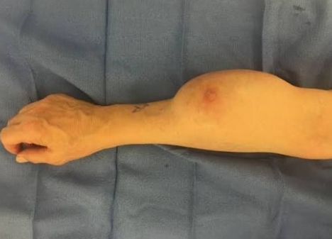
Project Overview
Background
Soft tissue sarcoma comprises a diverse group of rare cancers arising from connective tissues such as muscle, fat, nerves and blood vessels. Because of their rarity and complexity, understanding patient demographics, treatment patterns, metastasis and survival outcomes is essential for improving clinical decision-making.
Project Objective
This project aims to transform raw clinical data into an interactive Power BI dashboard that enables healthcare professionals to:
Understand patient demographics
Explore tumor characteristics
Analyze metastasis and recurrence
Evaluate treatment approaches
Assess survival outcomes

Slide 3
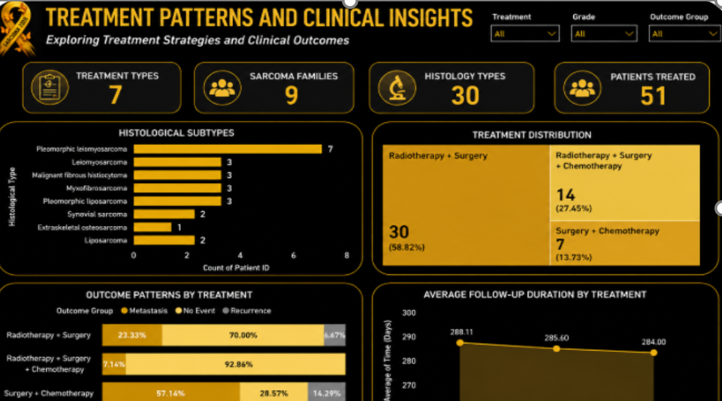
Dataset Overview
Dataset Description
Dataset Summary :
Total Patients: 51
Clinical Variables: 30+
Histological Types: 30
Sarcoma Families: 9
Treatment Categories: 3
Outcome Categories:
No Event
Metastasis
Recurrence
Data Preparation
The dataset underwent:
Data cleaning
Missing value handling
Standardization
Feature engineering
Relationship modelling
DAX measure creation

Slide 4
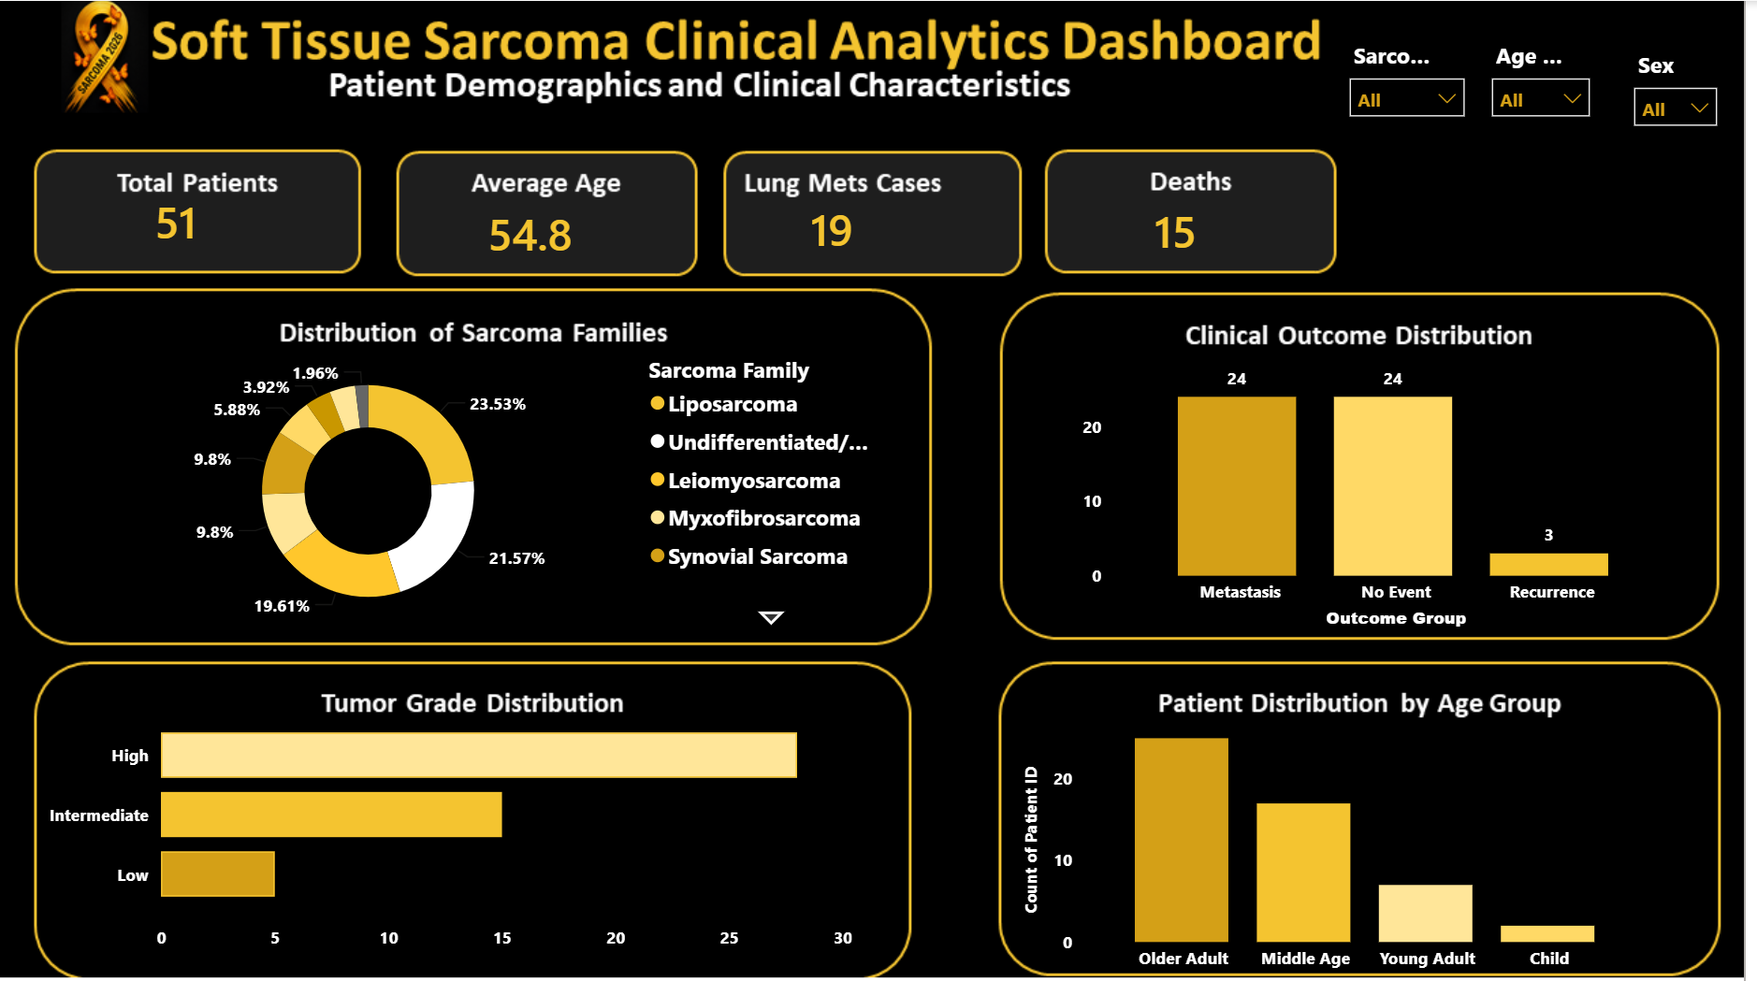
Dashboard Overview
Executive Summary
The dashboard provides a high-level overview of the clinical characteristics of 51 Soft Tissue Sarcoma patients, highlighting patient demographics, disease burden, tumor classification, and clinical outcomes.
Key Highlights
51 patients were included in the analysis.
The average patient age was 54.8 years, with Older Adults representing the largest age group.
19 patients developed lung metastasis, indicating a substantial metastatic burden.
15 deaths were recorded during the follow-up period.
Liposarcoma was the most frequently diagnosed sarcoma family.
High-grade tumors accounted for the largest proportion of cases.
Clinical outcomes were predominantly No Event and Metastasis, while Recurrence was relatively uncommon.

Slide 5
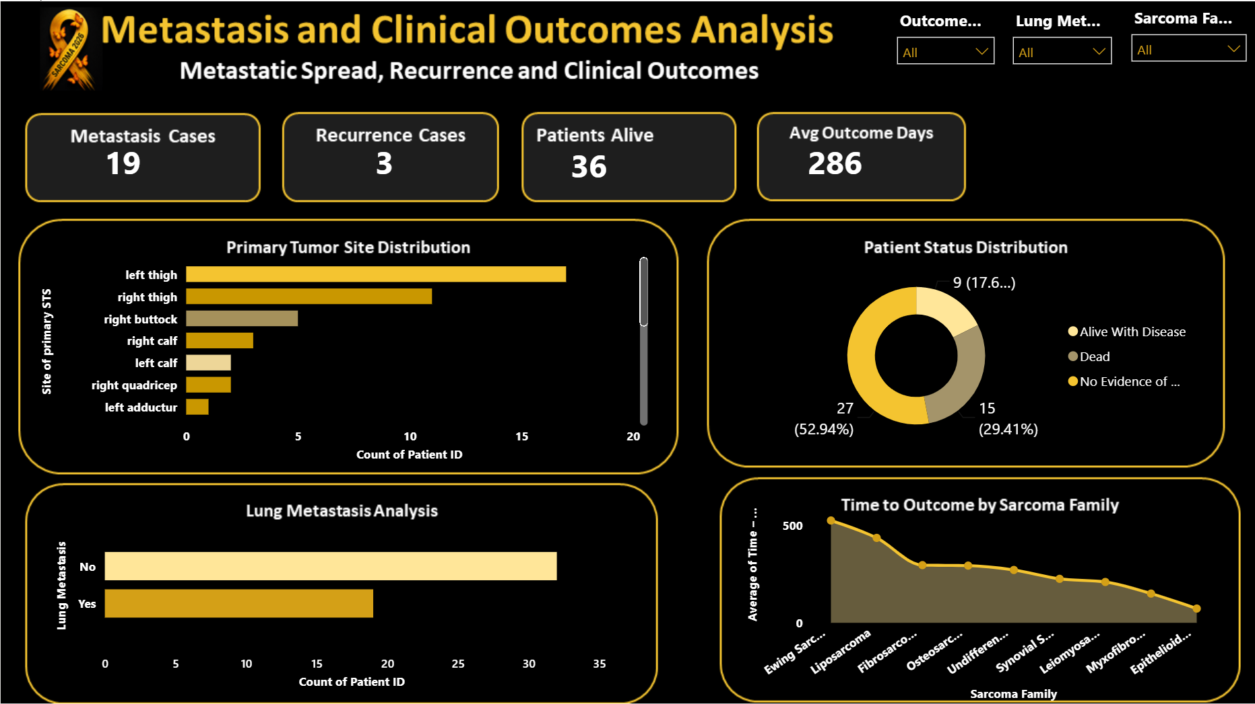
Metastasis & Clinical Outcomes
Key Findings :
19 patients developed lung metastasis, making it the most common metastatic event.
Recurrence was uncommon, with only 3 recorded cases.
Most patients achieved No Evidence of Disease (NED) following treatment.
Time to outcome differed across sarcoma families, suggesting variation in disease progression and prognosis.
Primary tumor sites were concentrated in the lower limbs, particularly the thigh region.

Slide 6
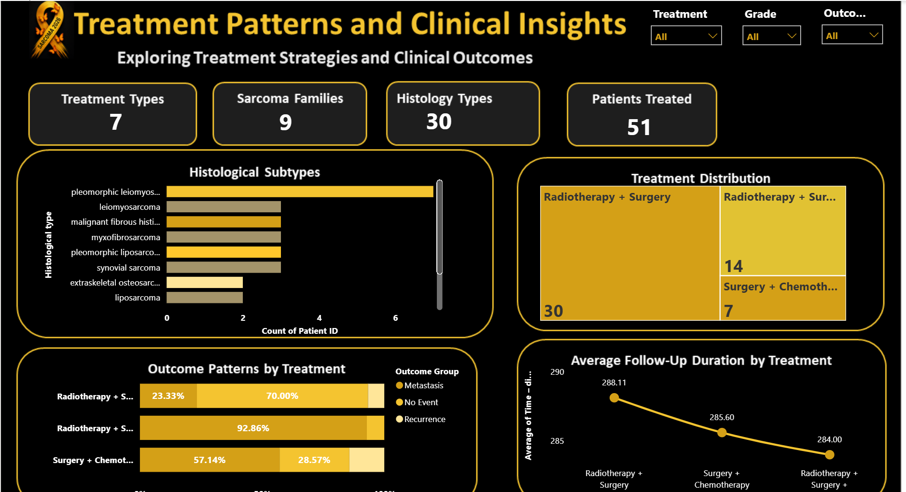
Treatment Patterns
Insight : The dashboard compares:
Histological subtypes
Treatment distribution
Clinical outcomes by treatment
Average follow-up duration
Observation :
Radiotherapy combined with surgery represented the most common treatment strategy in the dataset.

Slide 7
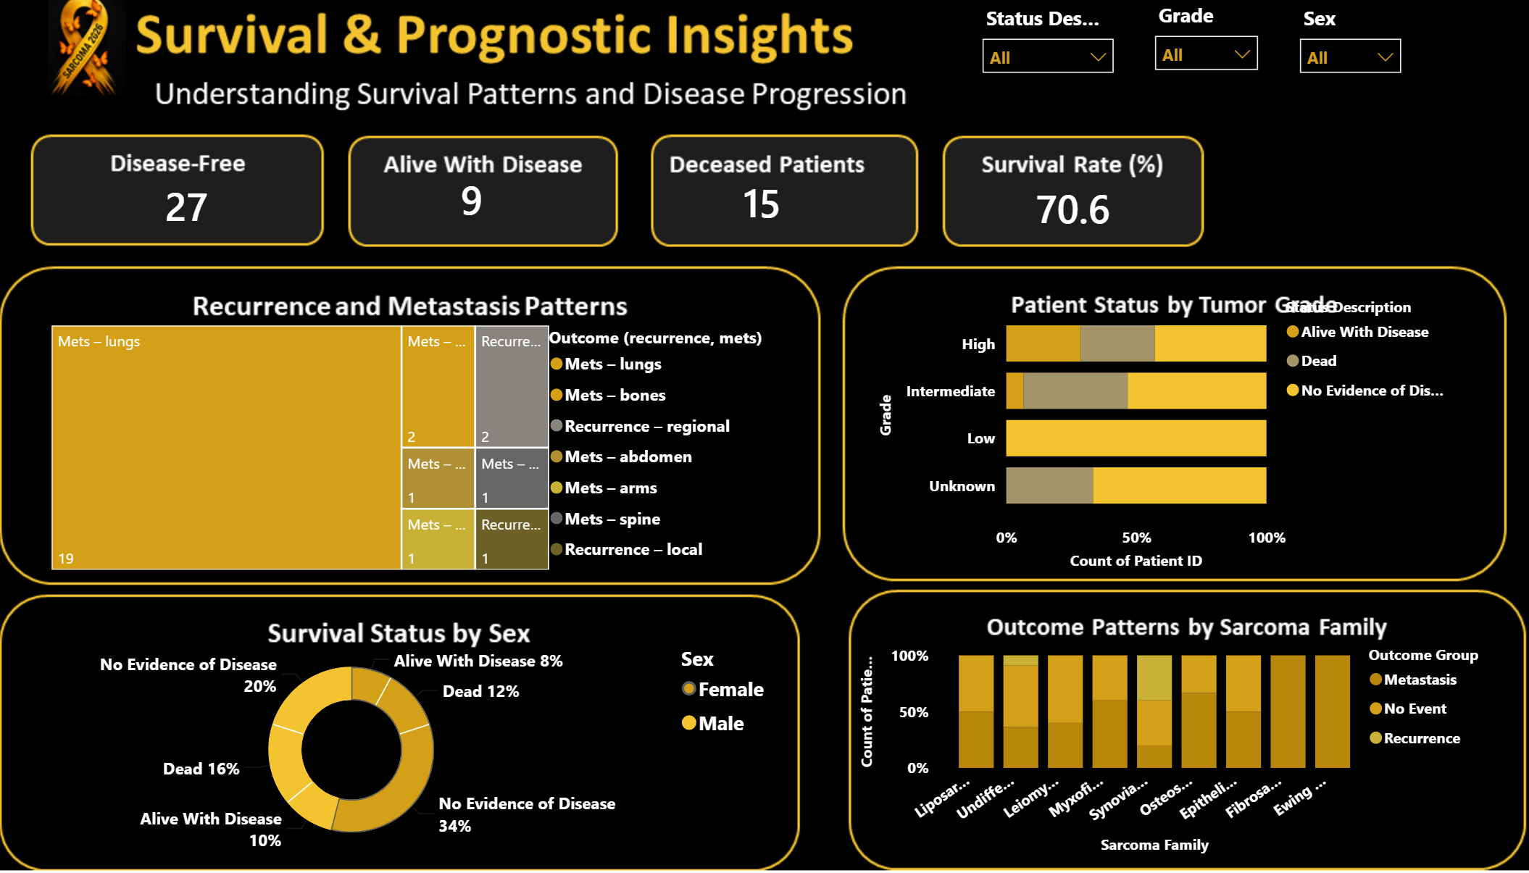
Survival & Prognostic Insights
Findings :
70.6% of patients remained disease-free during follow-up.
High-grade tumors were associated with less favorable patient outcomes than lower-grade tumors.
Survival outcomes varied across sarcoma families, highlighting differences in disease behavior.
Recurrence remained relatively uncommon compared with metastatic progression.
Survival patterns were comparable across male and female patients in this dataset.

Slide 8
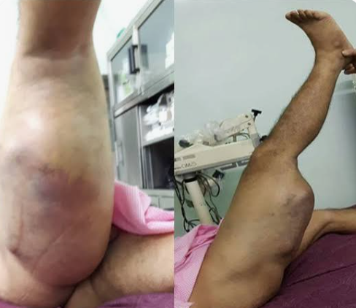
Key Business/Clinical Insights
Major Findings :
Liposarcoma represented the largest sarcoma family.
High-grade tumors were more common than low-grade tumors.
Older adults accounted for the majority of patients.
Lung metastasis was the predominant metastatic presentation.
Most patients achieved No Evidence of Disease following treatment.
Radiotherapy with surgery was the most frequently administered treatment.
Survival outcomes varied across sarcoma families.

Slide 9
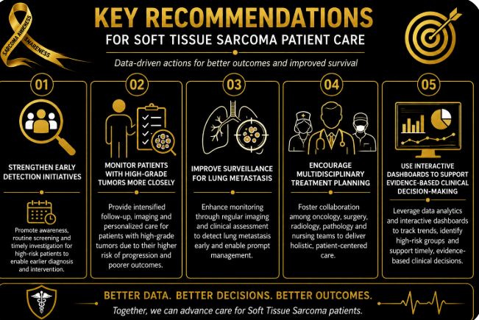
Recommendations
Clinical Recommendations :
Based on the findings:
Strengthen early detection initiatives for high-risk patients.
Monitor patients with high-grade tumors more closely.
Improve surveillance for lung metastasis.
Encourage multidisciplinary treatment planning.
Use interactive dashboards to support evidence-based clinical decision-making.

Slide 10

Conclusion
Clinical Recommendations :
Based on the findings:
This dashboard demonstrates how healthcare data can be transformed into actionable clinical insights using Power BI.
Through interactive visualizations, clinicians and healthcare administrators can better understand patient demographics, treatment patterns, metastatic progression, and survival outcomes to support evidence-based decision-making.

Slide 11


